Slide 1
DivDat Brand Guide
Presented By: Marketing
6/3/2022

Slide 2
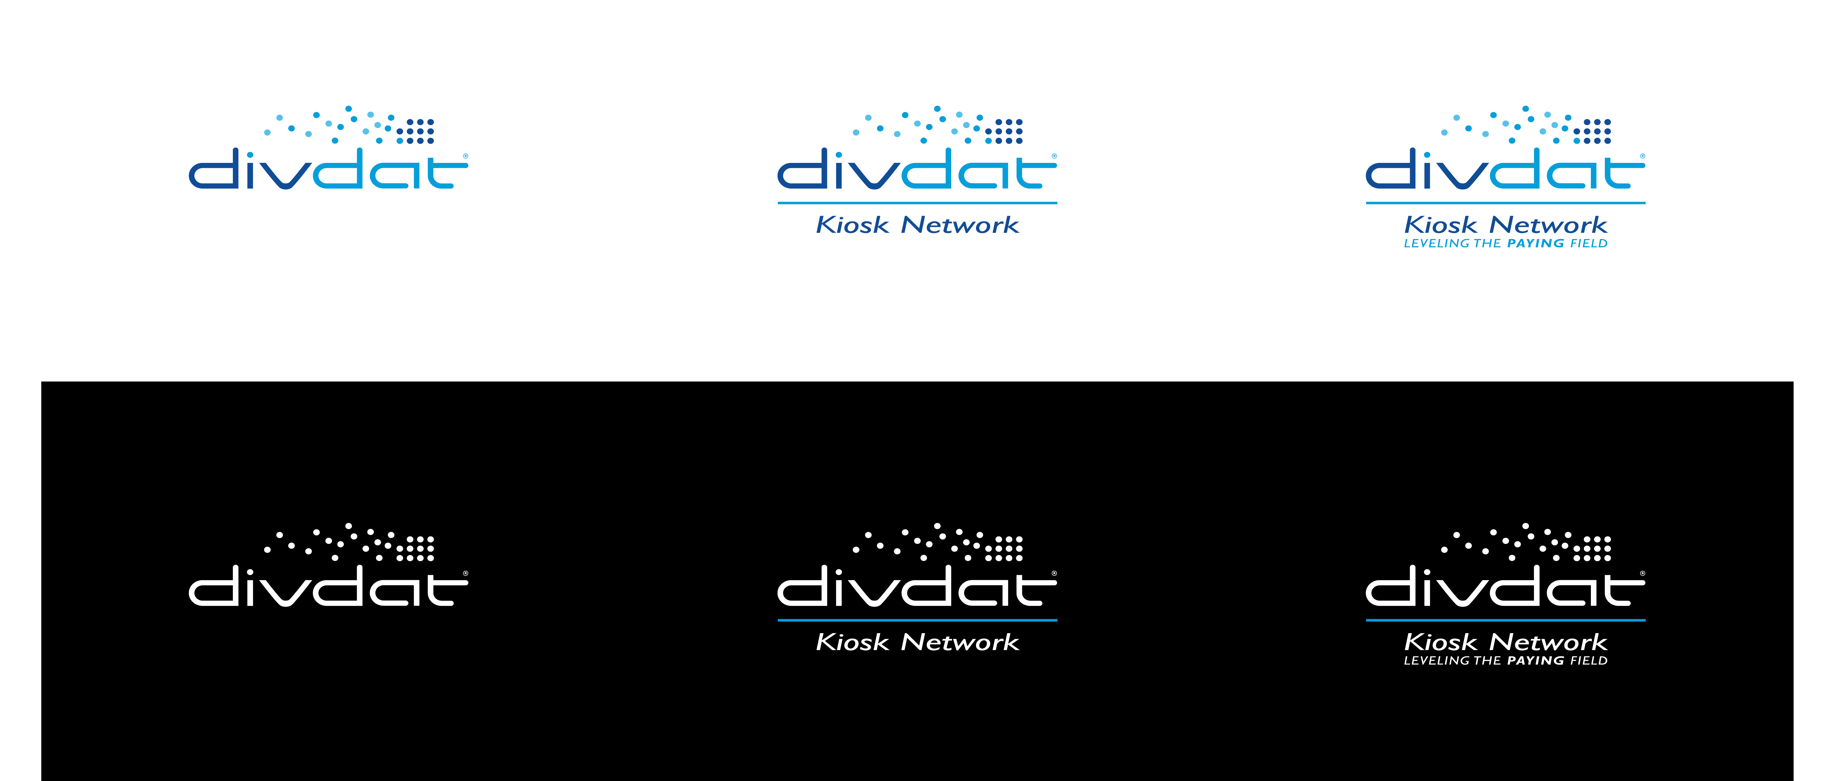
Current Logo Set

Slide 3
Updated Brand Foundations

Slide 4
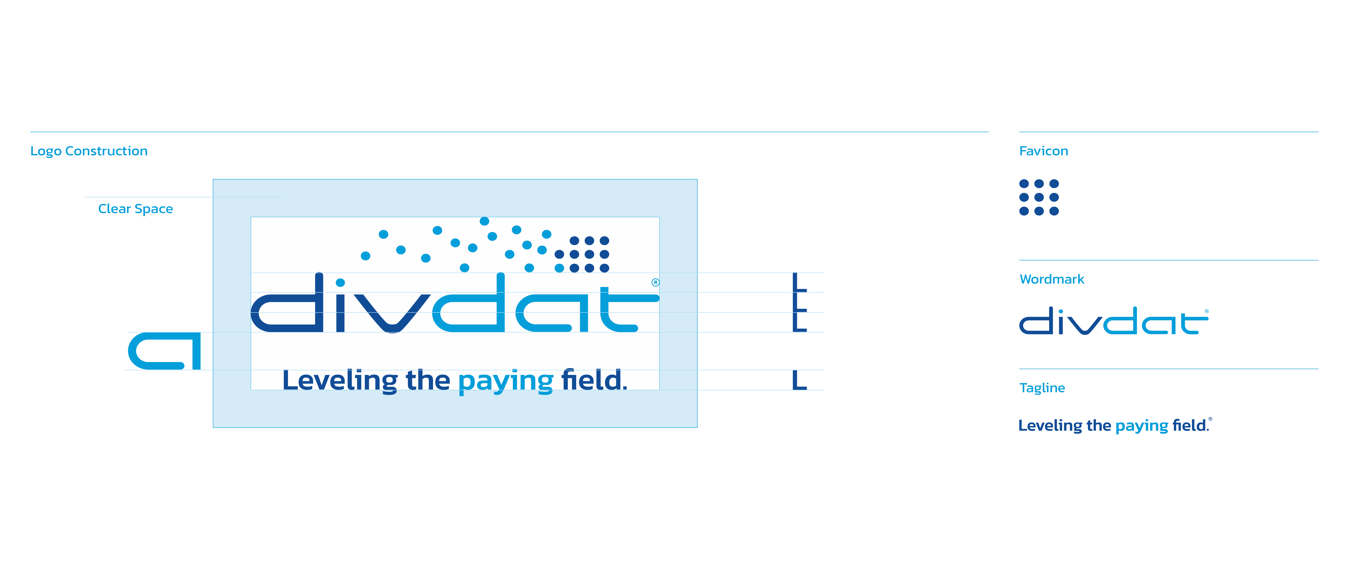
Logo Construction

Slide 5
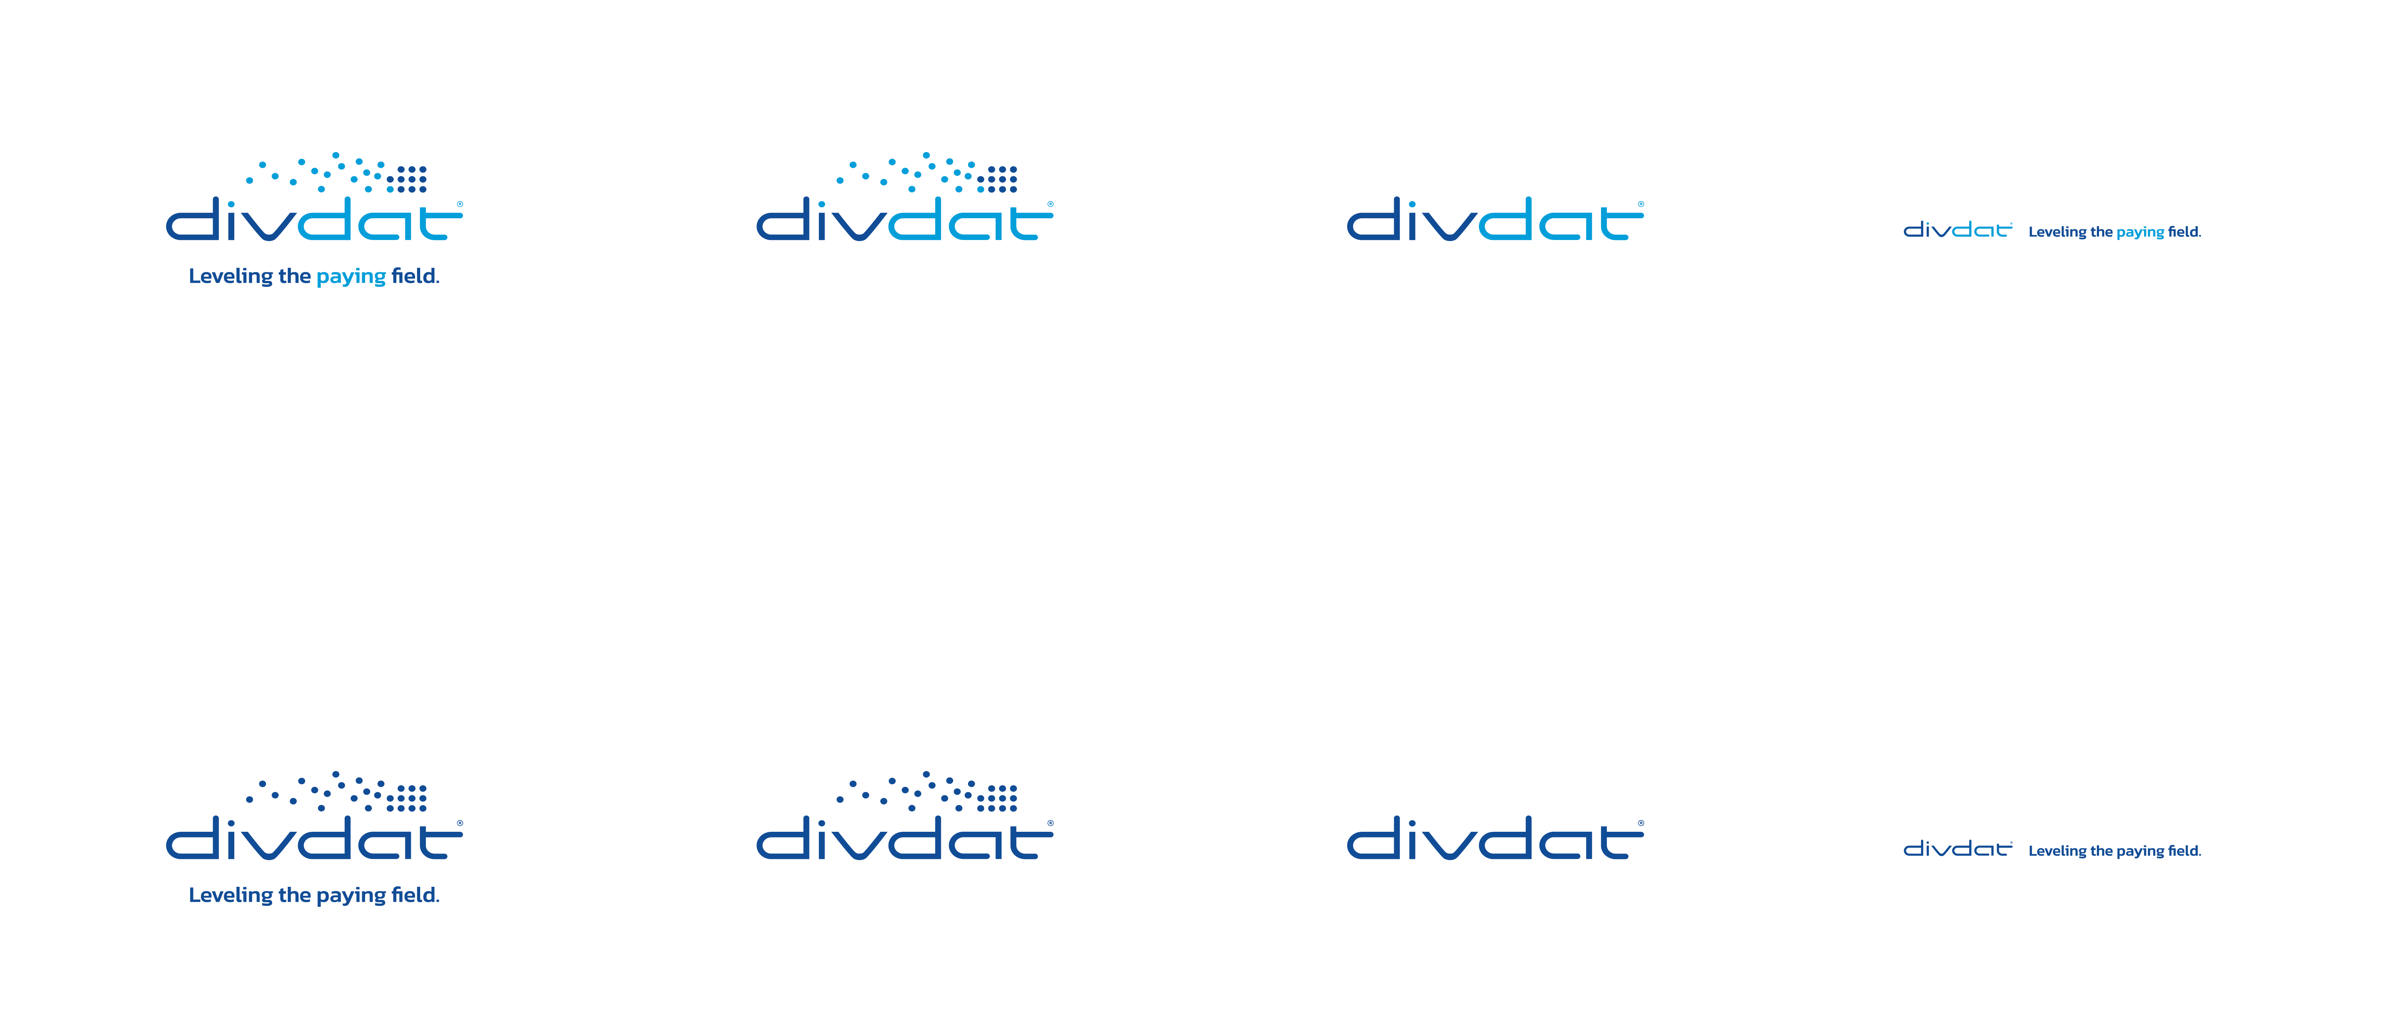
Updated Logo on a Light Background

Slide 6
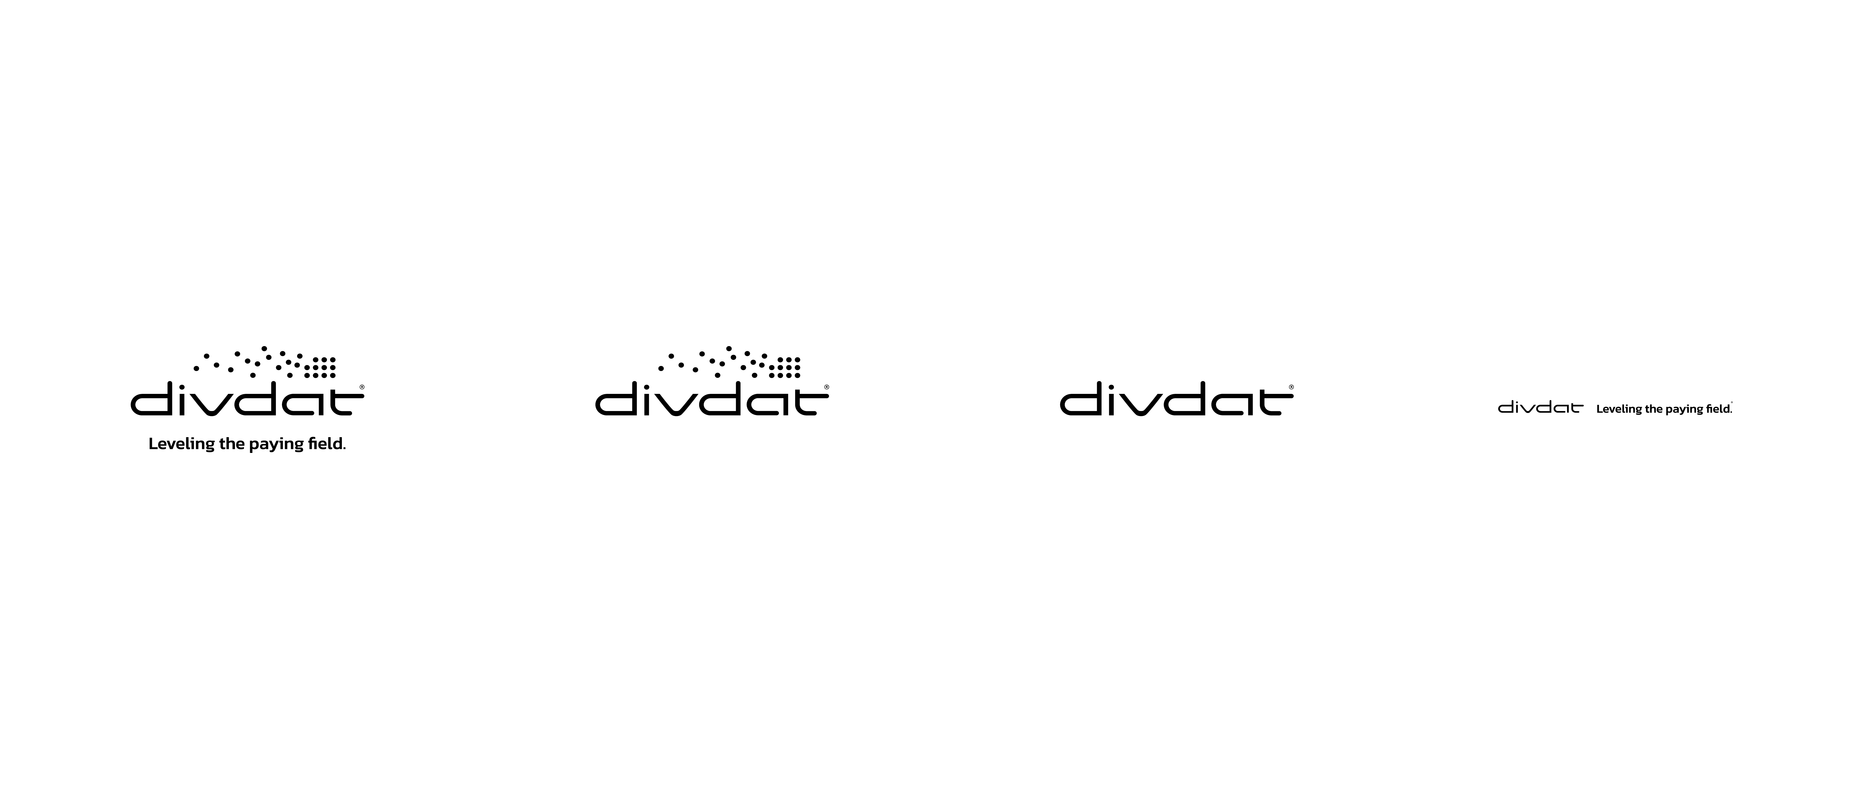
Updated Logo on a Light Background Black

Slide 7
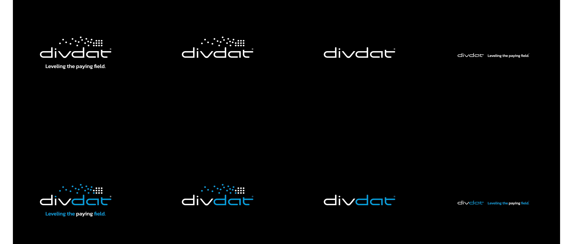
Updated Logo on a Dark Background

Slide 8
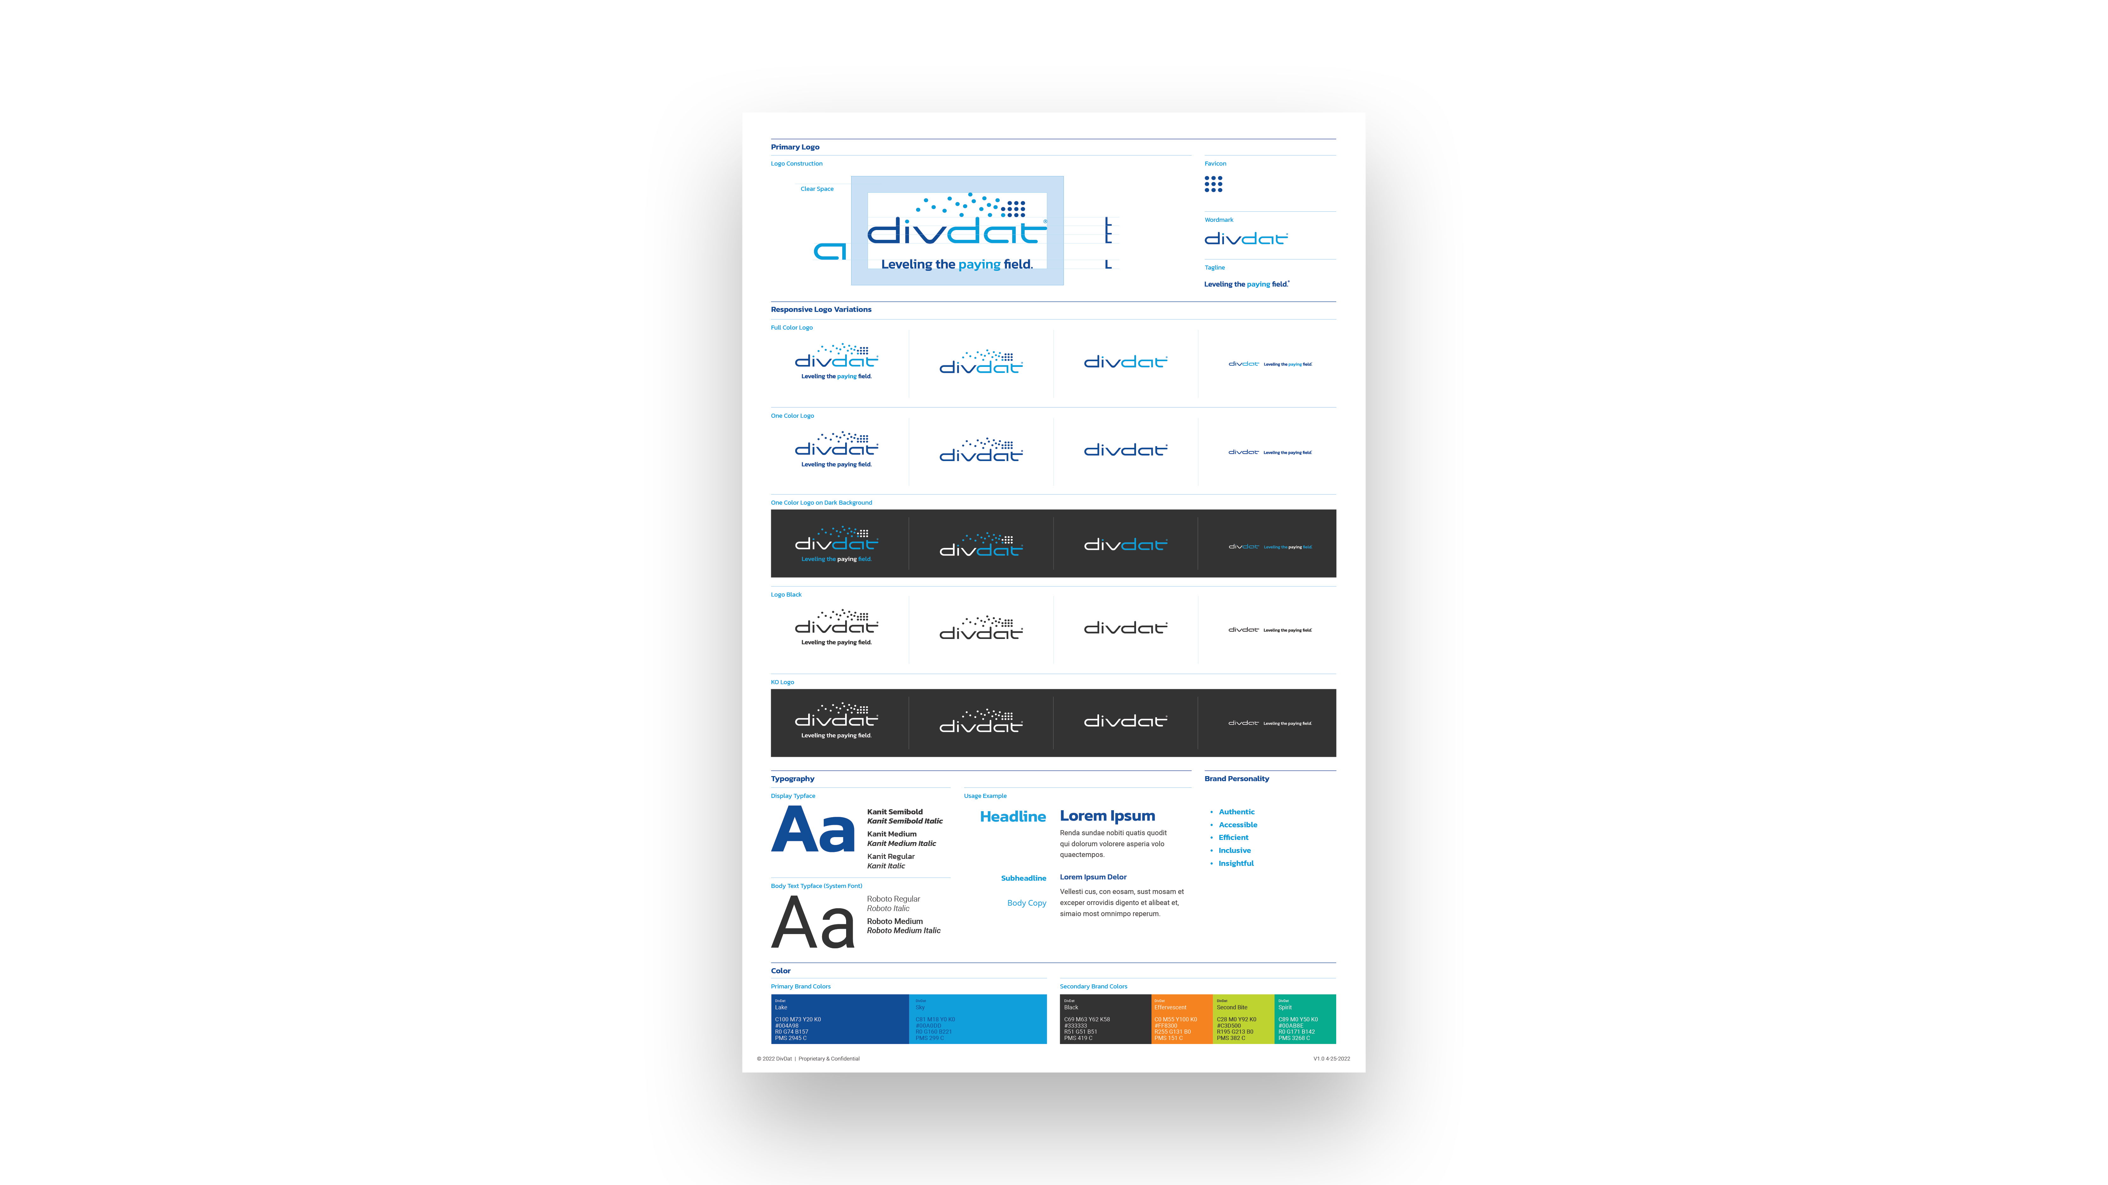
Style Sheet

Slide 9
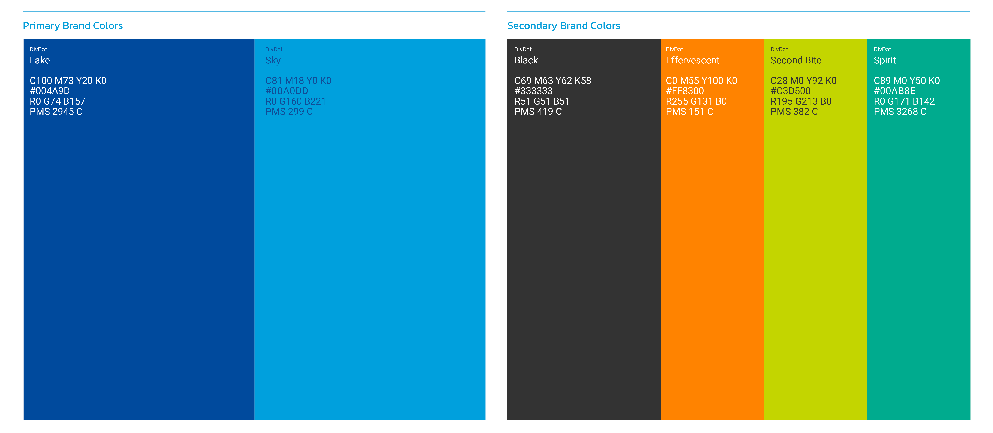
New Secondary Colors

Slide 10
Stationary Suite

Slide 11
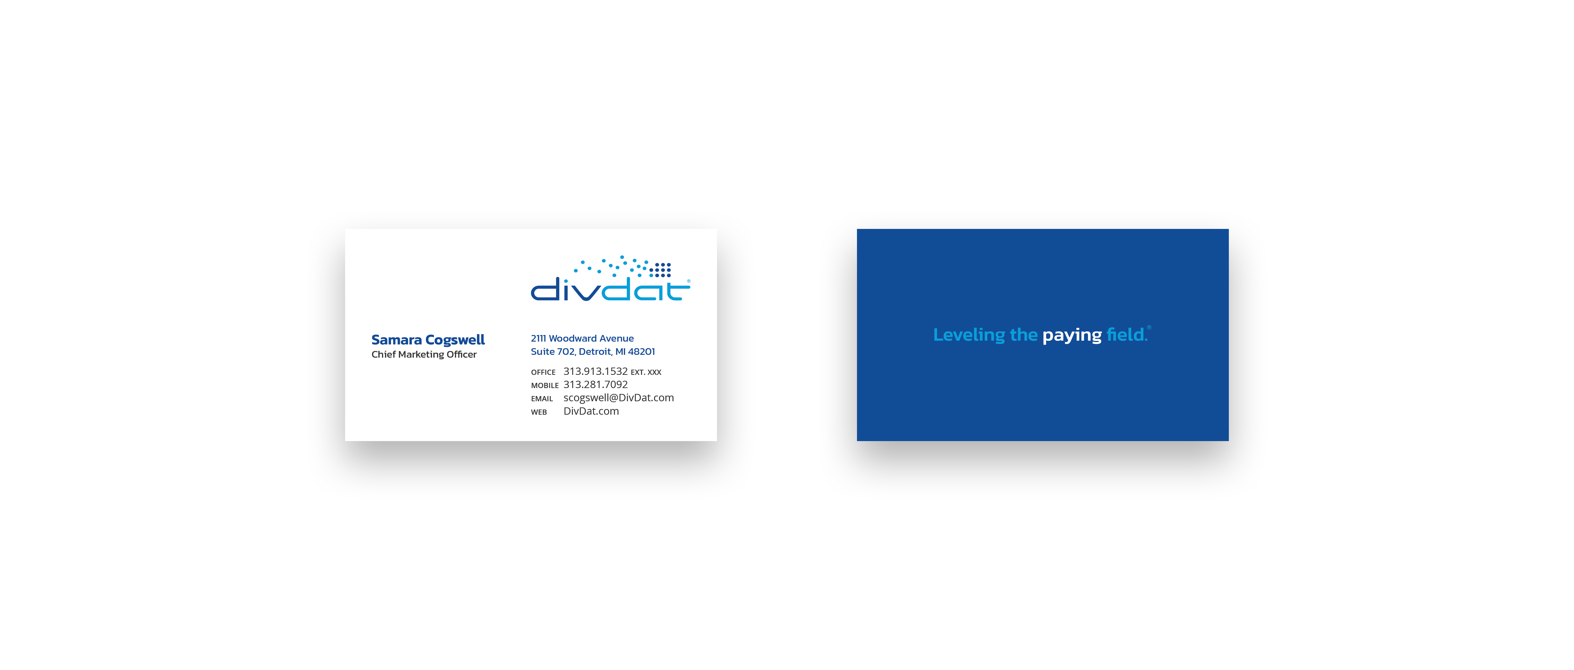
New Business Card Design

Slide 12
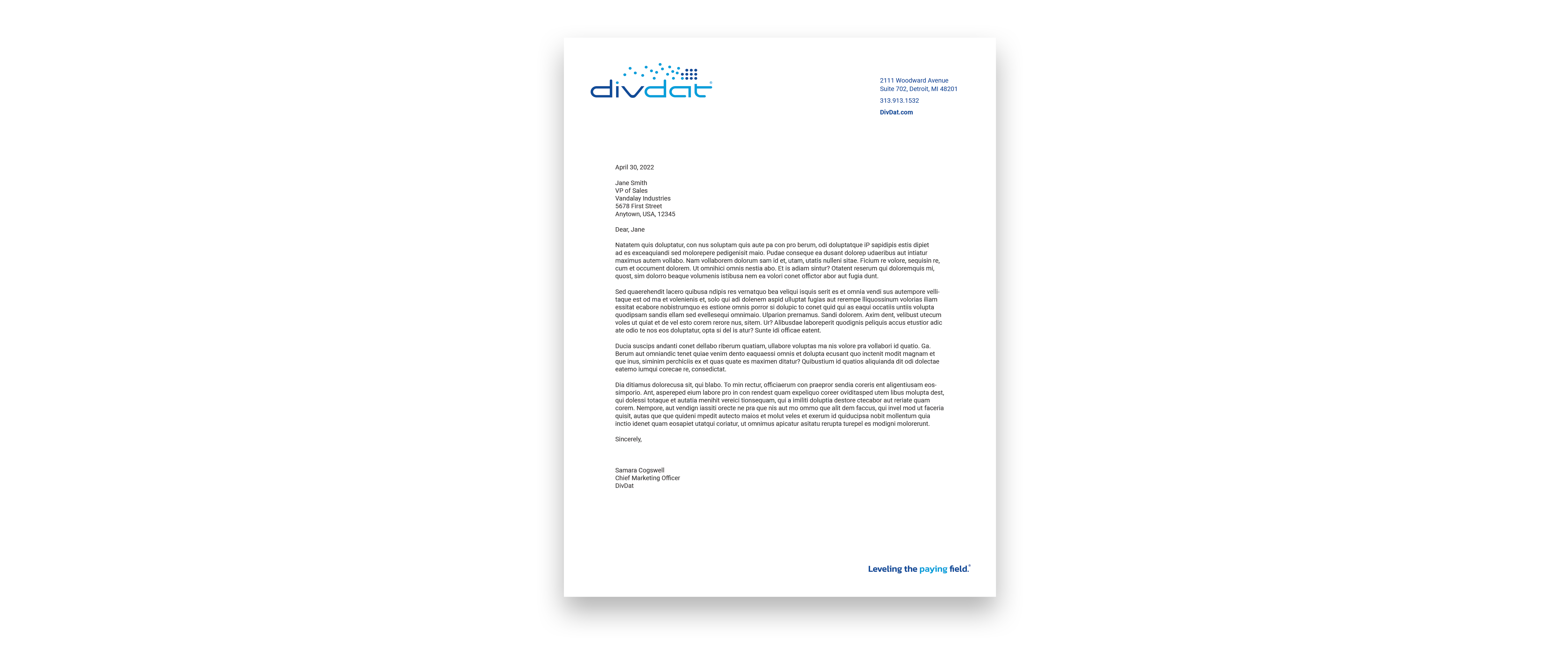
New Letterhead Design

Slide 13
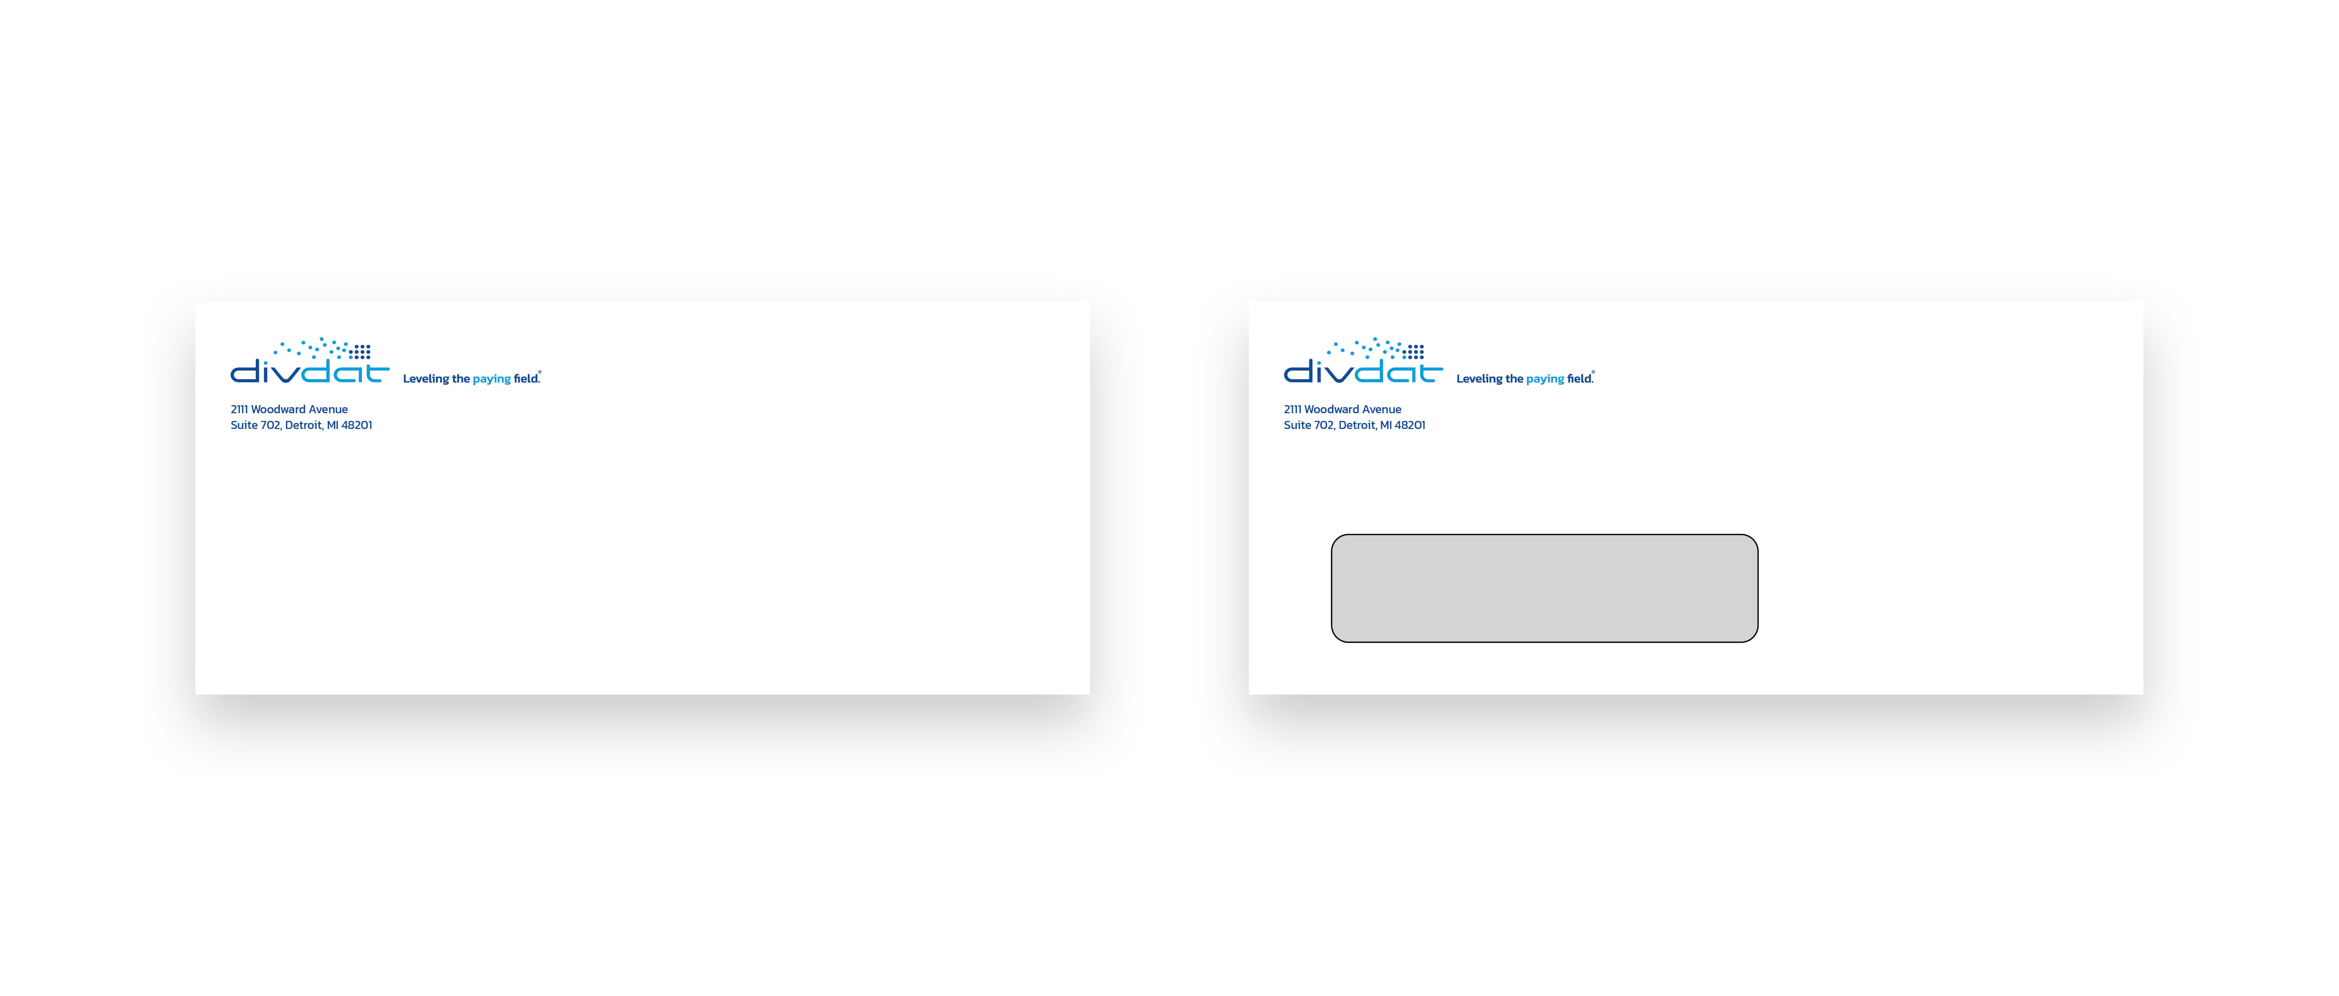
New Envelope Design

Slide 14
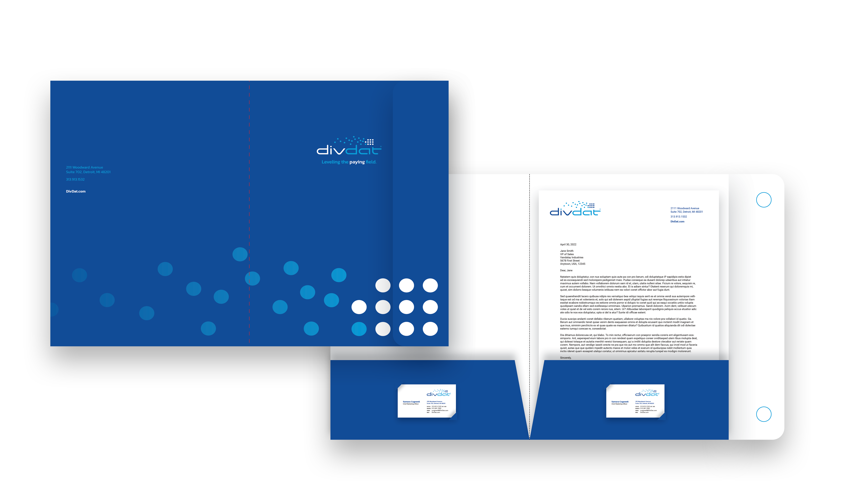
New Envelope Design

Slide 15
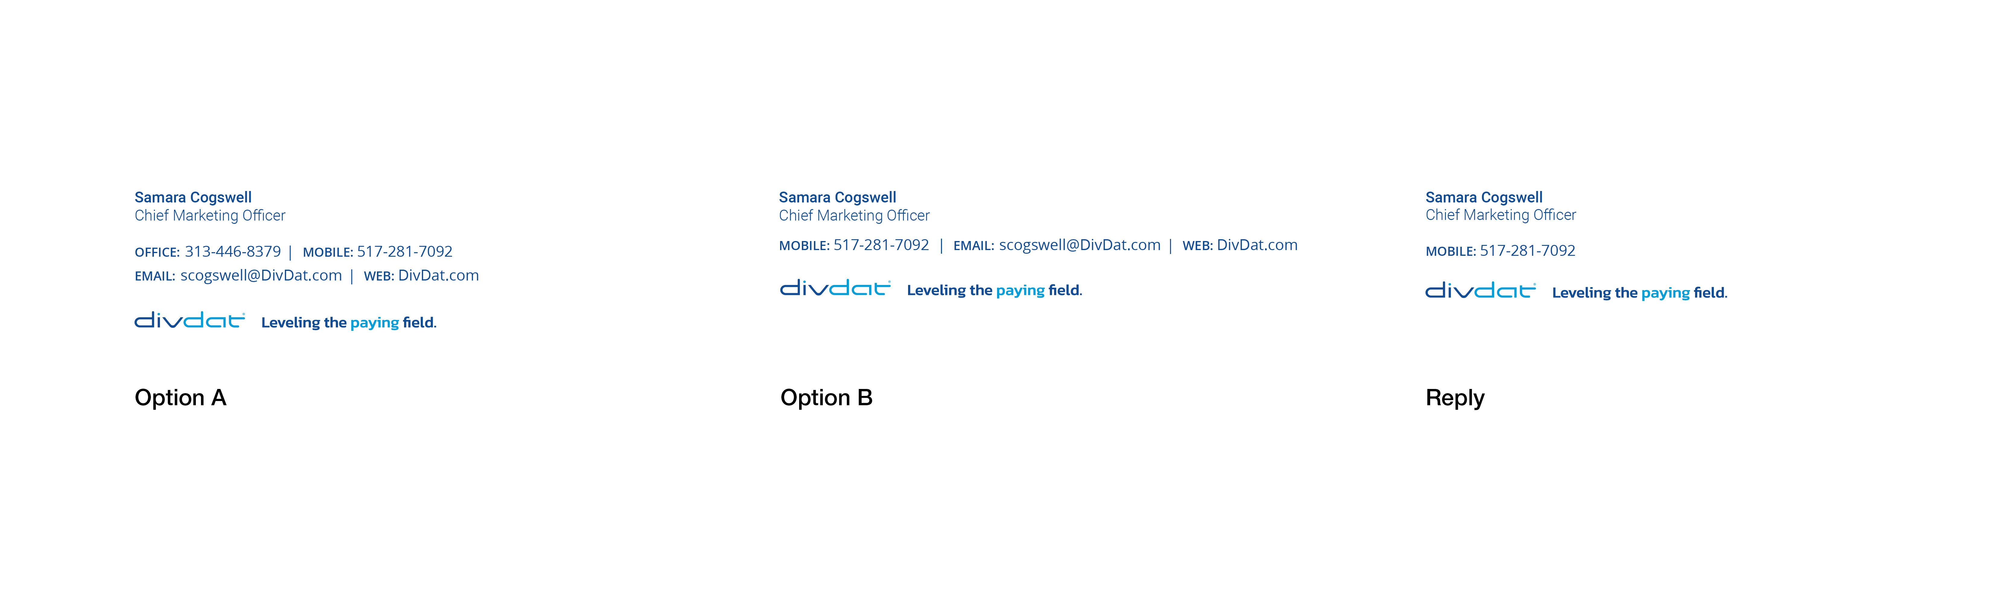
Email Signature

Slide 16
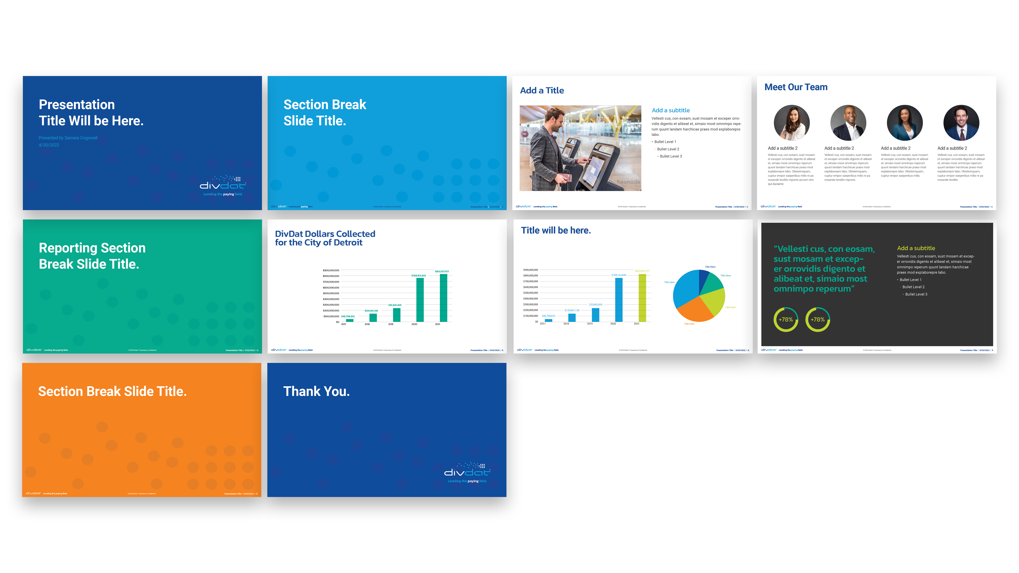
New PowerPoint Design

Slide 17
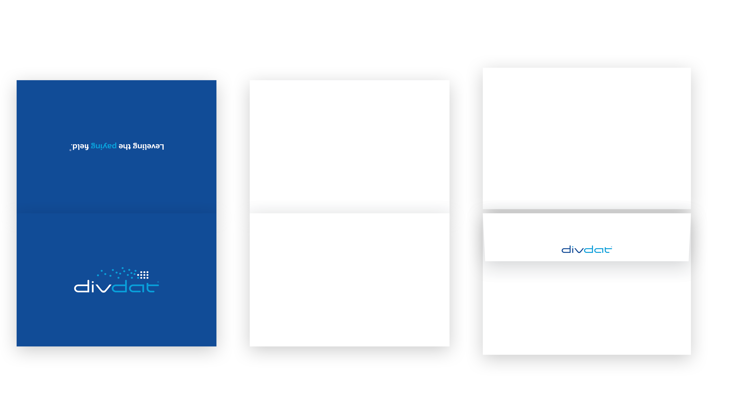
New Greeting Card Design

Slide 18
Thank You.

